Slide 1
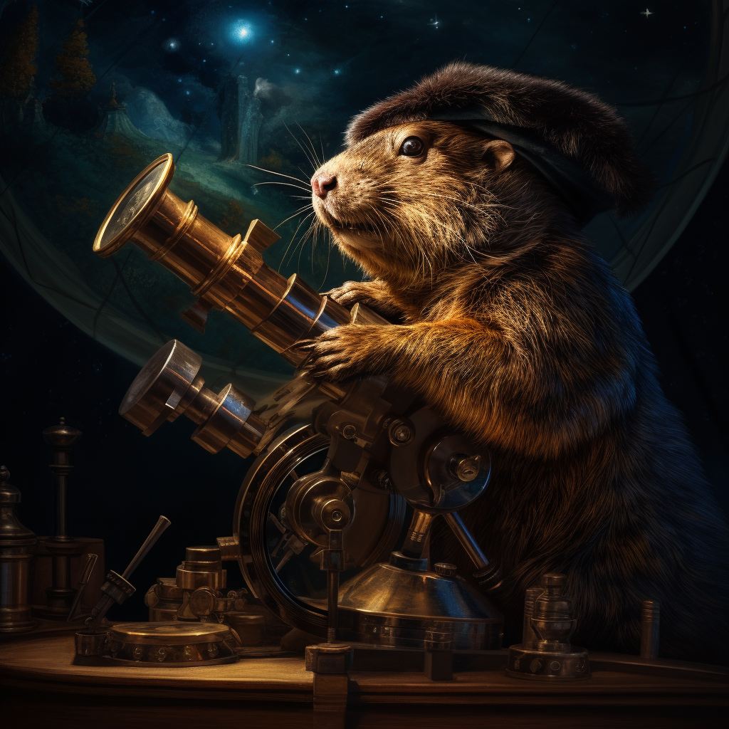

If Kepler had a computer
Python simulation of the solar system
Brescia, 11/12/2023

Slide 2
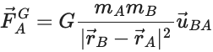
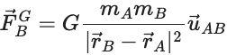
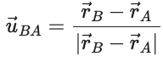
Let’s start simple
In the two-body problem, we want to simulate the dynamics of two objects interacting through gravitational force:

Slide 3
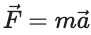
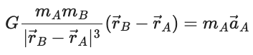
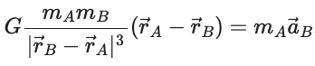
From Newton to Newton
Thanks to the 2nd law of motion , we can equate the forces:

Slide 4
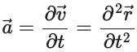
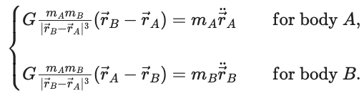
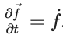
Differential equations 101
We have a system of differential equations! Indeed, so that we can re-write
These are 6 (second-order) Ordinary Differential Equations.

Slide 5
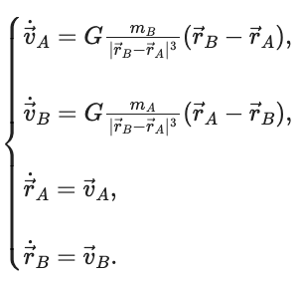
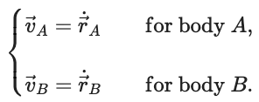
A common trick
We can lower the system’s order to 1 to make it easier to solve.
The trade-off is we get more equations in the system:

Slide 6
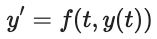
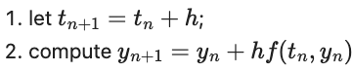
Numerical solving with Euler
Any first-order ODE system like can be simulated with the Euler method, i.e. iterating the following:

Slide 7
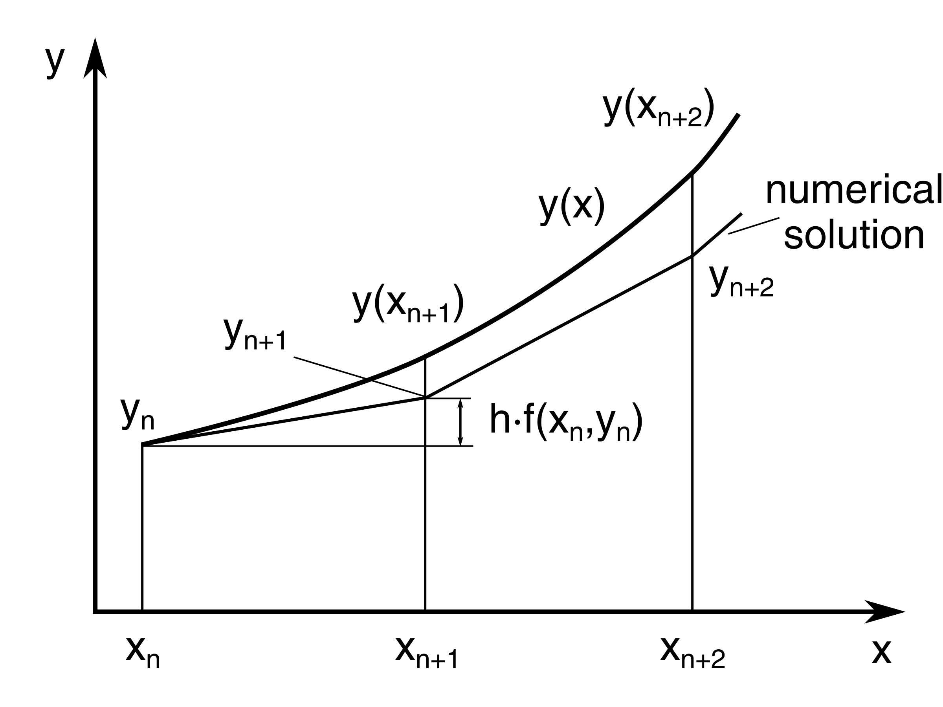

Why does it work?
It creates a piece-wise linear reconstruction of the solution by approximating its derivative to the first order.

Slide 8

DEMO TIME

Slide 9

Some Useful Resources
Resources
kepler
Enlightening Articles
Simulate a tiny solar system with Python
The two-body problem in Python
Numerical simulation of the planetary motions in the solar system...

